Slide 1
Virtual Machines and Web Sites

Slide 2
Agenda
Windows Azure Virtual Machines
  Portability
  Supported operating systems
Windows Azure Virtual Network
Windows Azure Web Sites
  Gallery
  Environments
  Scalability
Lab: a)Building a Virtual Machine
b)Building a Web Site

Slide 3
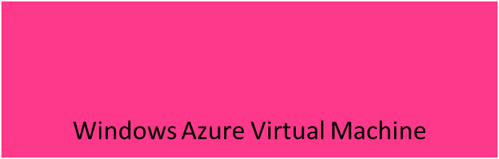
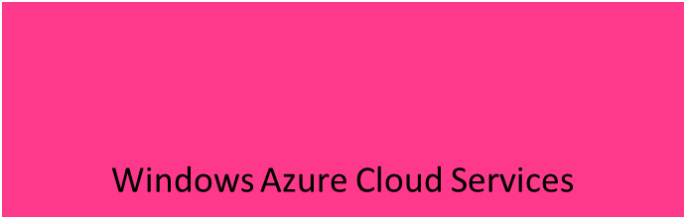
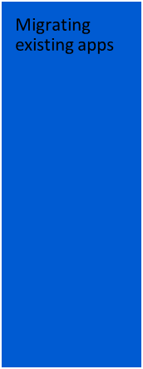

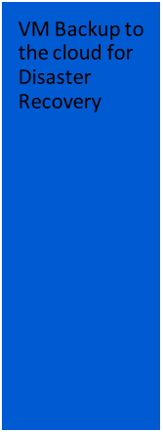
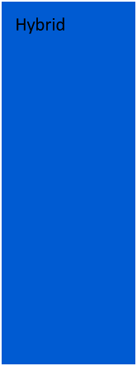
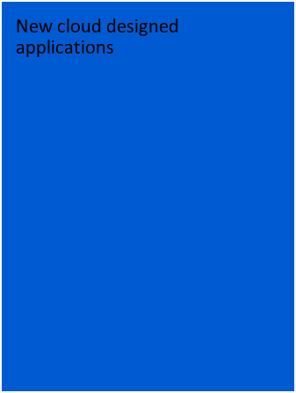

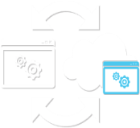
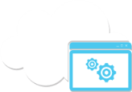







Key Scenarios – VMs and Cloud Services

Slide 4
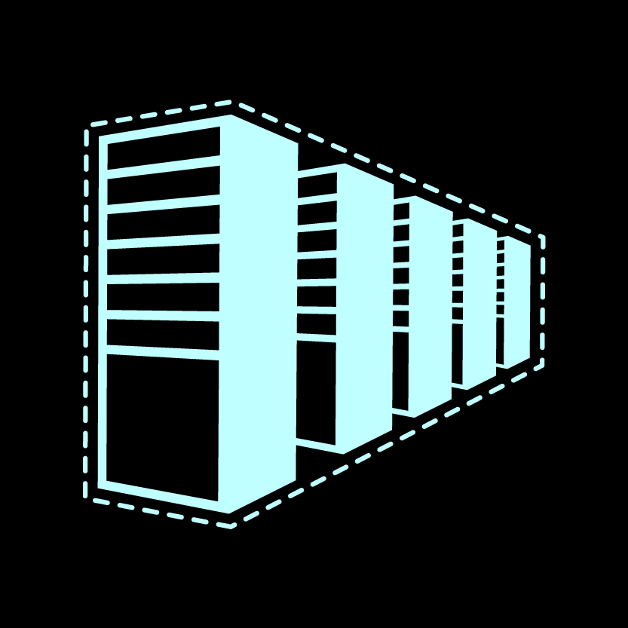


Why Use Virtual Machines for Existing Applications?
Management
Retain full control to configure & maintain the OS. Manage public & private cloud VMs centrally with Microsoft System Center.
Application Mobility
Move your virtual hard drives (VHDs) back and forth between on-premises and the cloud. No need to rebuild your app to run in the cloud.
Run popular Microsoft server applications
Run the same on-premises enterprise applications & infrastructure in the cloud, such as Microsoft SQL Server

Slide 5






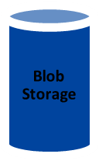

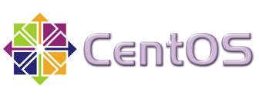




Windows Azure Virtual Machines
Boot VM from New Disk
Management Portal
Scripting
(Windows,
Linux and Mac)
REST API
Notes:
Not restricted to just these images. You can also upload your own image and use that, described later in the lecture.

Slide 6


Supported Operating Systems
Supported:
  Windows Server 2008 R2
  64-bit
Library Images:
  Windows Server 2008 R2
  Windows Server 2012 RC
  Windows Server 2008 R2 with SQL Server 2008 or 2012 (Available at GA. Only SQL Server 2012 Eval available at Preview))
Supported:
Community & commercial
distributions including
Library Images:
  SUSE Linux (SUSE Linux Enterprise Server SP2 & OpenSuse 12.1)
  CentOS (CentOS 6.2)
  Ubuntu (Ubuntu 12.04)
Linux

Slide 7




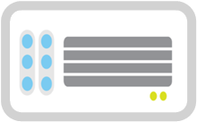
How it Works
Select from Image Gallery
Log in to
Windows Azure
Management Portal
Create new
VM from
image gallery
The image is copied to
your blob storage account
Virtual Machine booted. Changes copied
to blob storage

Slide 8




How it Works
Bring your own VHD
Create your own VHD
Upload image to blob storage
Create a disk using the uploaded image in the Windows Azure Management Portal
Virtual Machine booted. Changes copied to blob storage

Slide 9


How it Works
No Lock-In
Windows Azure
Uses standard VHD format, easy to move between Windows Azure and On-Premises Data Centers
Equally easy to directly move to another service provider that supports VHDs
Microsoft Data Center
Other Data Center

Slide 10


Create a new Windows Server 2012 machine
Notes:
Demo on Windows Azure portal

Slide 11
Networks

Slide 12











Cross-premise Connectivity
CLOUD
ENTERPRISE
Data Synchronization
SQL Azure Data Sync
Application-layer
Connectivity & Messaging
Service Bus
Secure Machine-to-Machine Network Connectivity
Windows Azure Connect
Secure Site-to-Site
Network Connectivity
Windows Azure Virtual Network
IP-level connectivity

Slide 13
Does Your App Need a Virtual Network?
Persistent IP Address Requirements
  Virtual Machines deployed into a virtual network have an infinite DHCP lease
Hybrid On-Premises Cloud Apps
  Requirement for connectivity between your data center and the public cloud
Connectivity between cloud services.
  Deploying Active Directory in the Cloud or connecting a PaaS to IaaS Service
Enterprise Identity and Access Control
  Manage identity and access control with on-premise resources
  (on-premises Active Directory)
Monitoring and Management
  Remote monitoring and trouble-shooting of resources
  running in Windows Azure

Slide 14




Windows Azure Networking
Virtual Network
  For network administrators
  Provides network admins the control to
  setup subnets in the Cloud and manage
  them as extensions of on-premise datacenters
Subnets in
Windows Azure
On-premise subnets

Slide 15

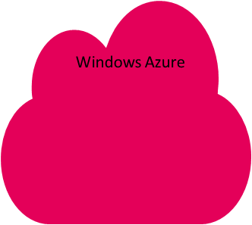



Windows Azure Virtual Network
“Virtual” datacenter in the cloud
  Enables extension of Enterprise Networks into Windows Azure
  Networking on-ramp for migrating existing apps
  and services to Windows Azure
  Enables “hybrid” apps that span cloud and on-premises
Protected private virtual network in the cloud
  Enables customers to setup secure private IPv4 networks fully contained within Windows Azure
  Inter-service DIP-to-DIP communication

Slide 16
Identity Management
Active Directory and Windows Azure

Slide 17
AD in the Cloud
Support pre-requisites for other apps or services
  Direct Authentication for Applications in the cloud
  Federation with ADFS
Serve as a substitute or failover for existing domain
Serve as primary authority for cloud only data center

Slide 18
Deploying AD in a Windows Azure VM
Cloud Service with Initial Domain Controller
  Virtual Network Name
  Existing DNS Servers (If any)
  Virtual Network Subnet
  Domain Join Settings (If existing domain)
  Separate Data Disk for Active Directory Database
  DCPromo
Create Separate Cloud Service for AD Members
  Specify DNS at Deployment Level Using PowerShell for VMs

Slide 19
Cloud Services Configuration for AD
The Domain Controller can be located wherever convenient:
  Domain Controller in Separate Cloud Service
  Domain Controller On-Premises
  Domain Controller in the Cloud
On-premises and Cloud can have separate Domain Controllers

Slide 20

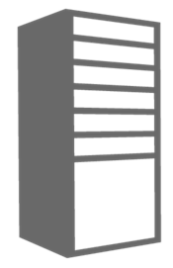
Domain Controller in Separate Cloud Service
Cloud Service for AD Domains
Location: North Central US
Name: ad-cloudservice.cloudapp.net
Affinity Group: ADAG
Cloud Service for AD Clients
Location: North Central US
Name: app-cloudservice.cloudapp.net
Affinity Group: ADAG
Deployment
Virtual Network: ADVNET
DNS Ips: (On-Premise AD IP)
Deployment
Virtual Network: MyVNET
DNS Ips: 192.168.1.4
Virtual Machine
Role Name: ad-dc
Subnet: ADSubnet
IP Address: 192.168.1.4
DIP
Virtual Machine
Role Name: advm1
Subnet: AppSubnet
IP Address: 192.168.2.4

Slide 21
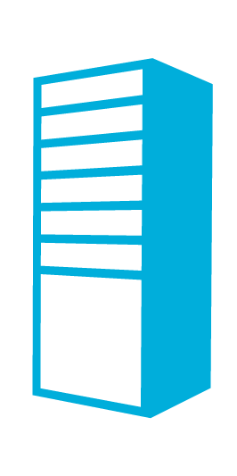


Domain Controller On-Premises
Contoso.com Active Directory
Contoso.com Active Directory
Contoso Corp Network
The Virtual Network
in Windows Azure
SQL Servers
IIS Servers
Site to Site VPN Tunnel
AD Authentication
+
On-Premises Resources
Gateway
AD / DNS
S2S VPN
Device
IIS Servers
SQL Servers
Exchange
Load Balancer
Public IP

Slide 22


Domain Controller in the Cloud
Contoso.com Active Directory
Contoso.com Active Directory
Contoso Corp Network
The Virtual Network
in Windows Azure
SQL Servers
IIS Servers
Site to Site VPN Tunnel
AD / DNS
AD Replication
+
On Premises Resources
Gateway
AD / DNS
S2S VPN
Device
AD Auth
IIS Servers
SQL Servers
Exchange
Load Balancer
Public IP

Slide 23


Active Directory Cloud Only
Contoso.com Active Directory
Contoso Corp Network
Extranet Active Directory
The Virtual Network
in Windows Azure
SQL Servers
IIS Servers
Site to Site VPN Tunnel
AD / DNS
On Premises Resources
Gateway
AD / DNS
S2S VPN
Device
AD Auth
IIS Servers
SQL Servers
Exchange
Load Balancer
Public IP

Slide 24
Web Sites

Slide 25
Windows Azure Web Sites
More like SaaS than PaaS
No need to handle Firewall Rules
Gallery provides many popular applications, such as:
  DotNetNuke
  Drupal
  Joomla
  WordPress
Build with ASP.NET, Node.js or PHP
Use Windows, Mac or Linux machines for development
Deploy using FTP, Git or TFS

Slide 26
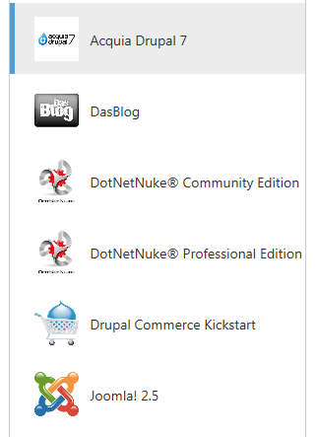
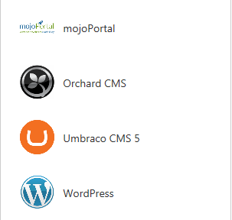
Web Sites Gallery

Slide 27
Create a new Web Site from the Gallery

Slide 28
Development Environments
Choice of Web Frameworks
  ASP .NET
  Classic ASP
  PHP
  Node.js
Databases
  SQL Database
  MySQL

Slide 29





Development Environments
Development OS
  Windows
  Linux
  Mac
Publishing Methods
  FTP
  Git
  Web Deploy
  TFS Deploy
Source Control
  Git
  TFS
GIT : FTP
1010111001010101010001010100011
GIT : FTP
1010111001010101010001010100011
GIT : FTP
Web Deploy : TFS Deploy
1010111001010101010001010100011

Slide 30
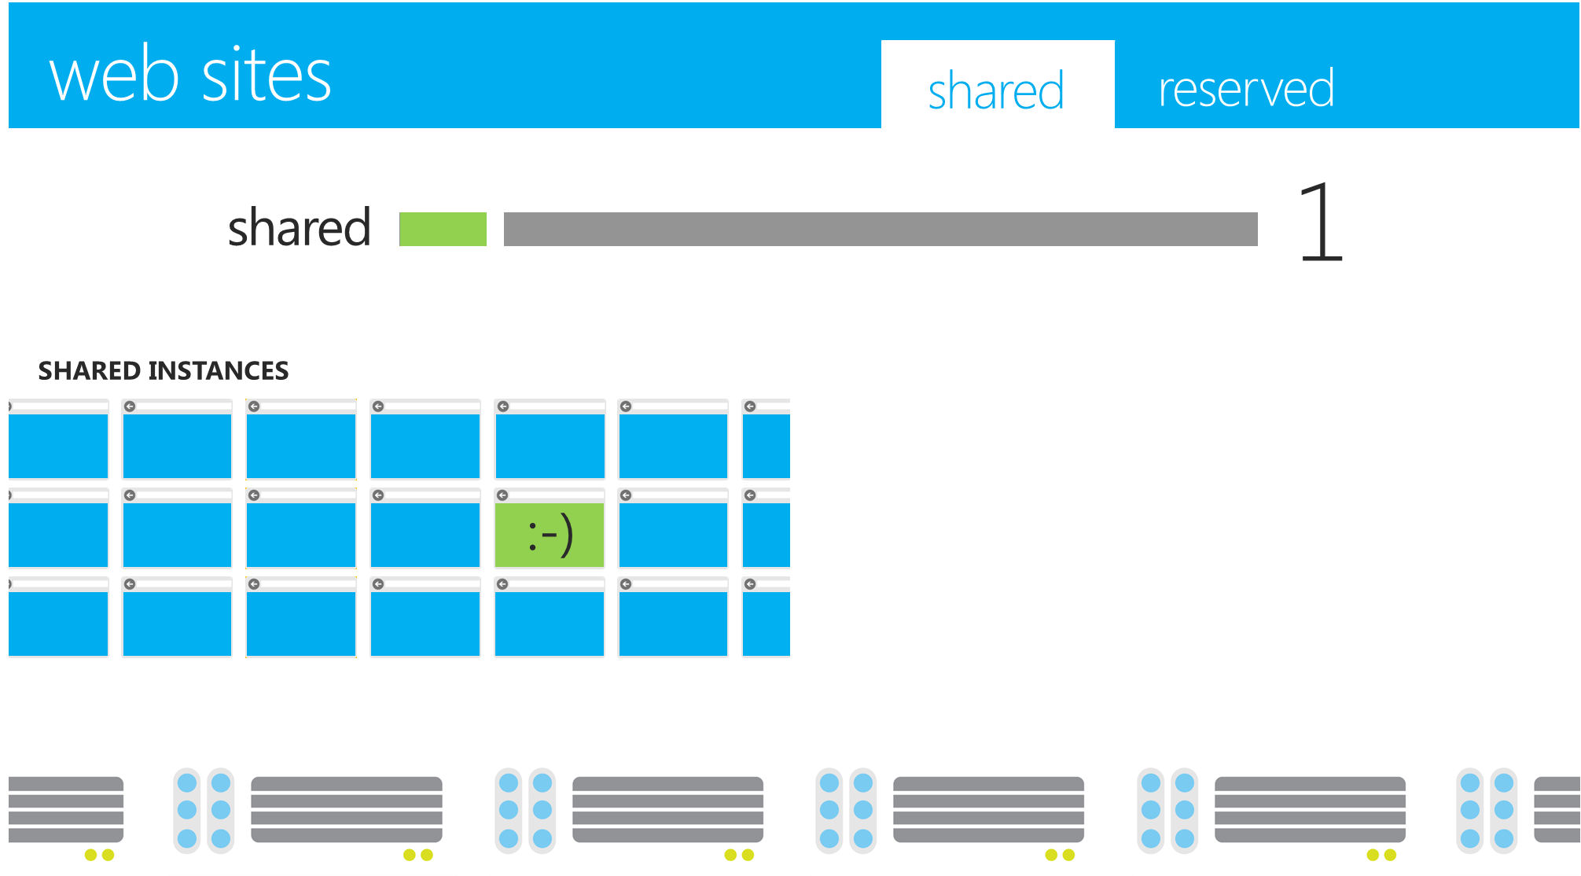
Scalability
Start with free shared instance

Slide 31
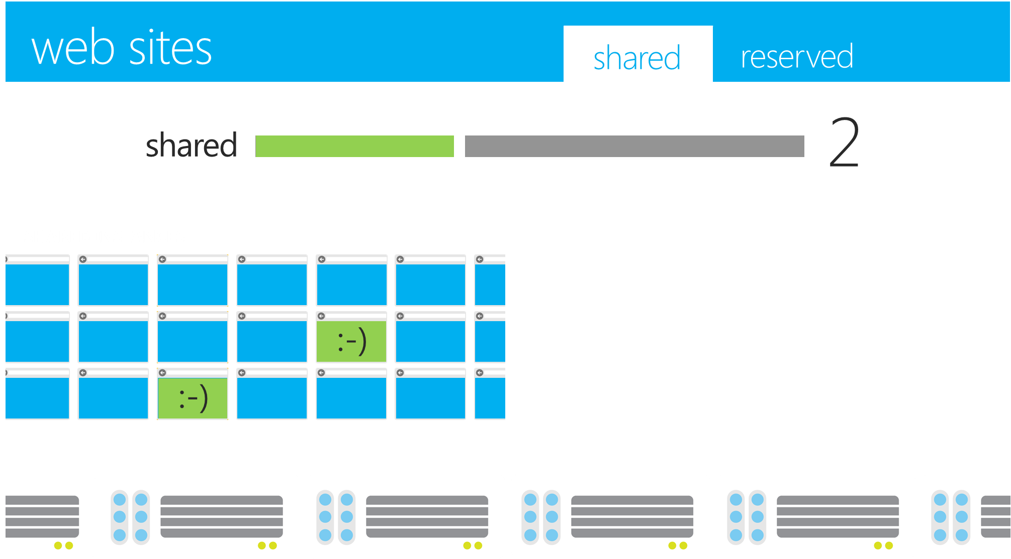
Scalability - Out
Start with free shared instance, Scale Out as traffic grows

Slide 32
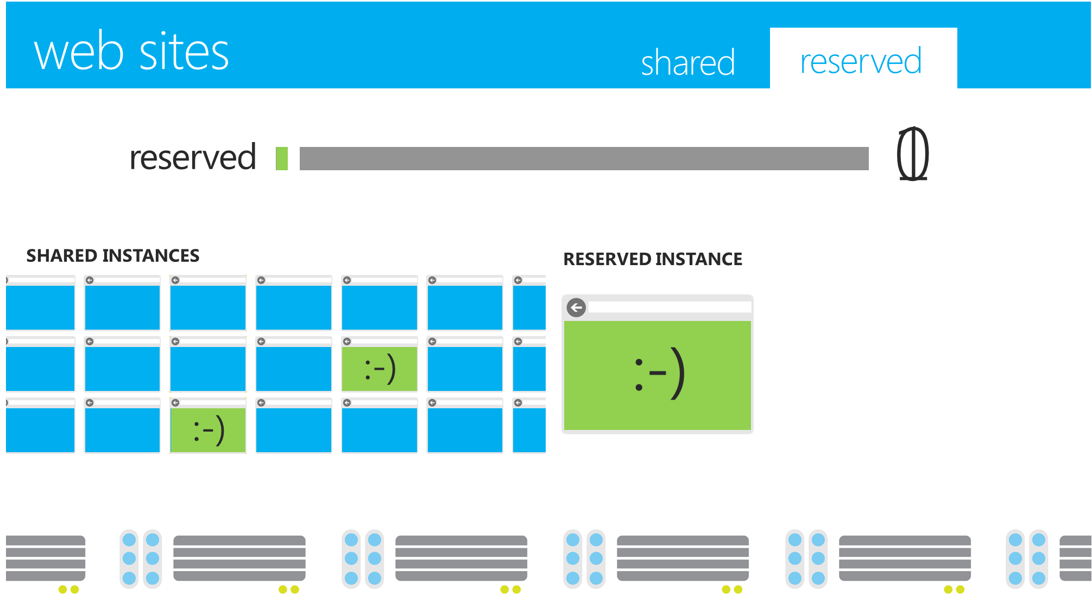
Scalability – Switch Up
Start with free shared instance, Scale Out as traffic grows, Scale Up to reserved instance when required

Slide 33
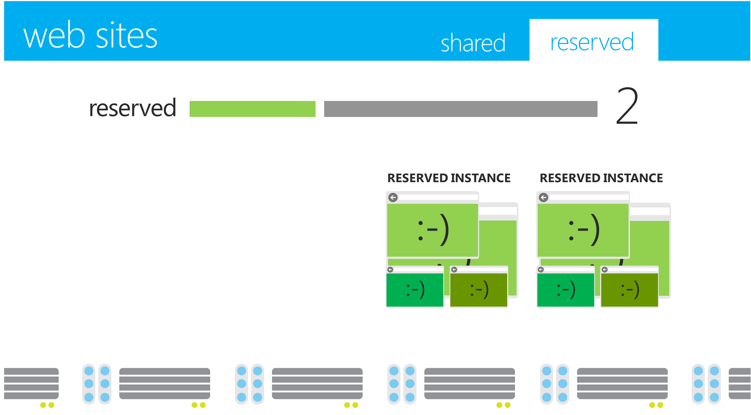
Scalability – Out again
Start with free shared instance, Scale Out as traffic grows, Scale Up to reserved instance when required
Scale Out even further!

Slide 34
Advantages of Cloud
Different Cloud accounts have identical environments
  There are invariably minor differences between different machines in on-premises environments
  Many Cloud platforms support quick roll back of changes in production
    By providing a Swap operation between two deployments
No risk of development and testing staff accidentally testing on live data
  Access to the production storage and databases can be controlled and isolated from the test storage and databases

Slide 35
and the Disadvantages…
Any time you do something, even if it is only testing, it costs money
Billed for all environments used – Production, Staging and testing
Connectivity issues can hinder testing and diagnosis

Slide 36
Deployment Best Practices
  Use scripts because it means that operations can be repeated reliably
  Log, so that errors are captured, which may assist in debugging problems
Automate as much of the process as possible

Slide 37
Testing
  Test locally first – does not cost
    For Windows Azure, most testing can be performed on the development machine by using the Compute Emulator and Storage Emulator
Deploy an application to the Cloud test environment only when it is running successfully locally and ready for final testing to minimize the charges
  Windows Azure charges separately for production and staging, so make sure that staging is deleted when not required
Be aware of the charging unit
  Windows Azure Compute is charged by the hour, so a 10 minute test will cost the same as a 59 minute test
  Windows Azure SQL Database is charged by the maximum size per day, so a 5 GB test database used for 1 hour will cost more than a 1 GB test database used for 1 day

Slide 38
Quiz
Q: Windows Azure Virtual Machines are available out of the box with which of the following operating systems:
  Ubuntu Linux
  VMS
  CentOS
  MVS
Ans: Ubuntu and CentOS. VMS is a legacy OS that was available for DEC machines, and MVS is for IBM Mainframes

Slide 39
Quiz
Q: Windows Azure Web Sites Gallery contains which of the following open source offerings:
  Joomla
  OSCommerce
  Magento
  WordPress
Ans: Joomla and WordPress

Slide 40
Thanks !~

